Slide 1

Small Angle Scattering Analysis Toolkit
Northern Lights on Food Masterclass VII
Wojtek Potrzebowski
SciLifeLab Lund
wojtek.potrebowski@scilifelab.se

Slide 2
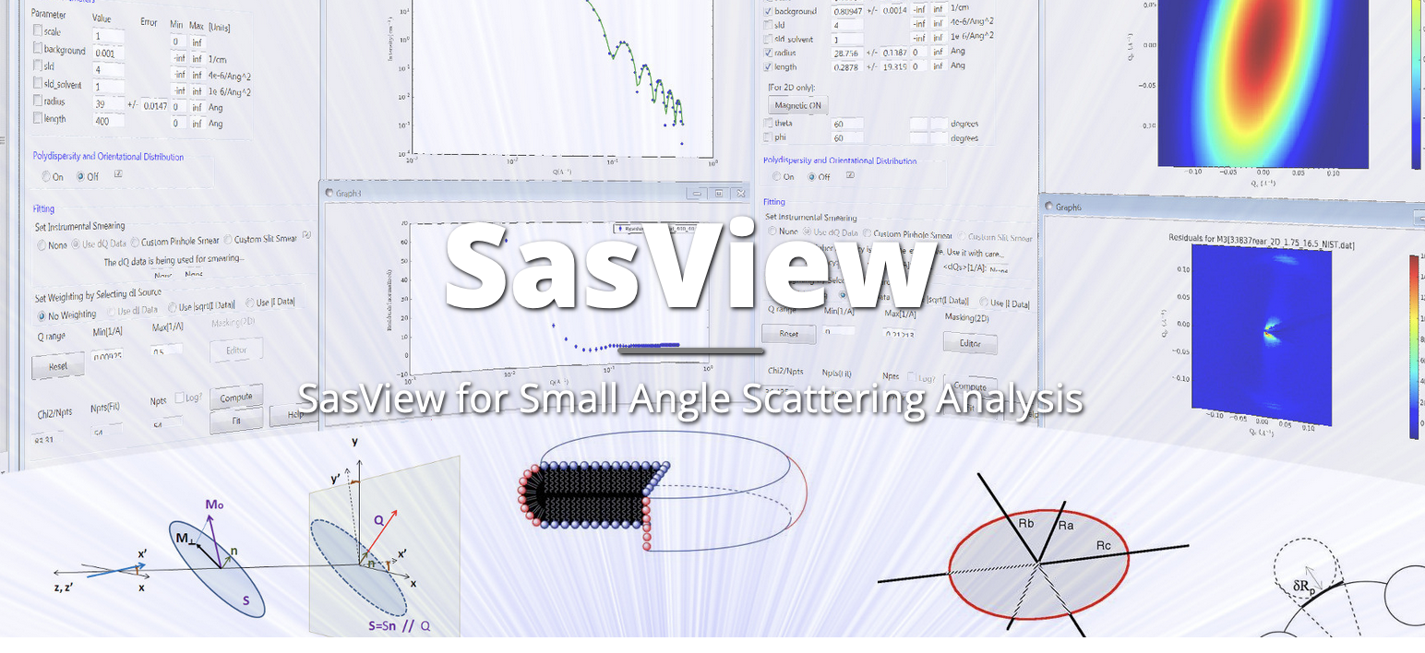
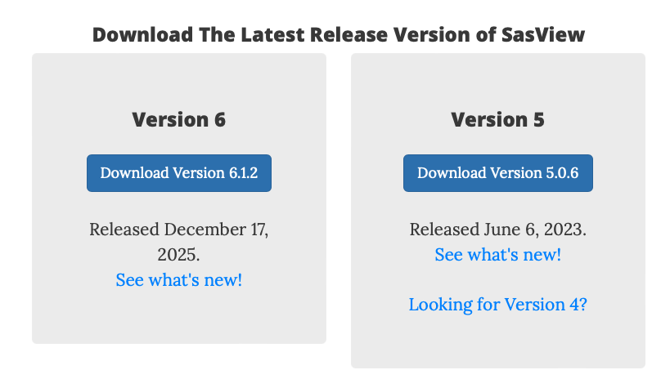
Before we start…
www.sasview.org

Slide 3
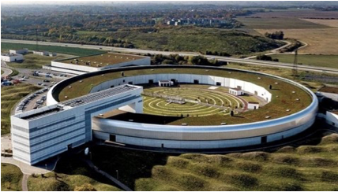
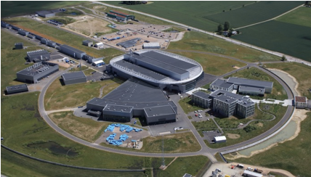
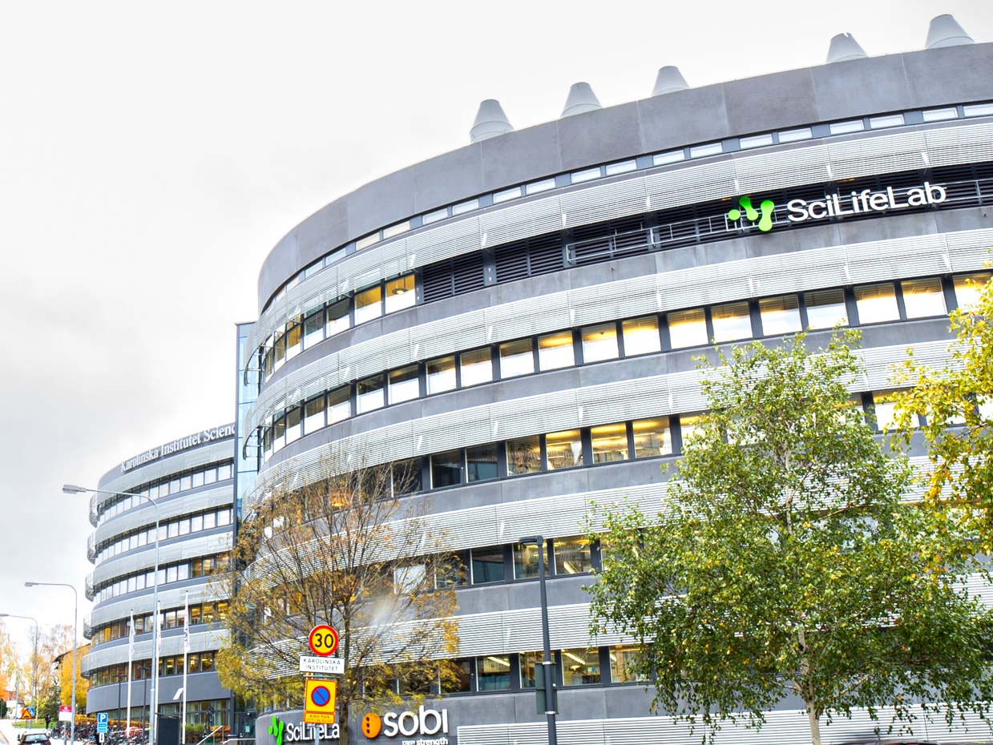



Research Infrastructures in Sweden

Slide 4
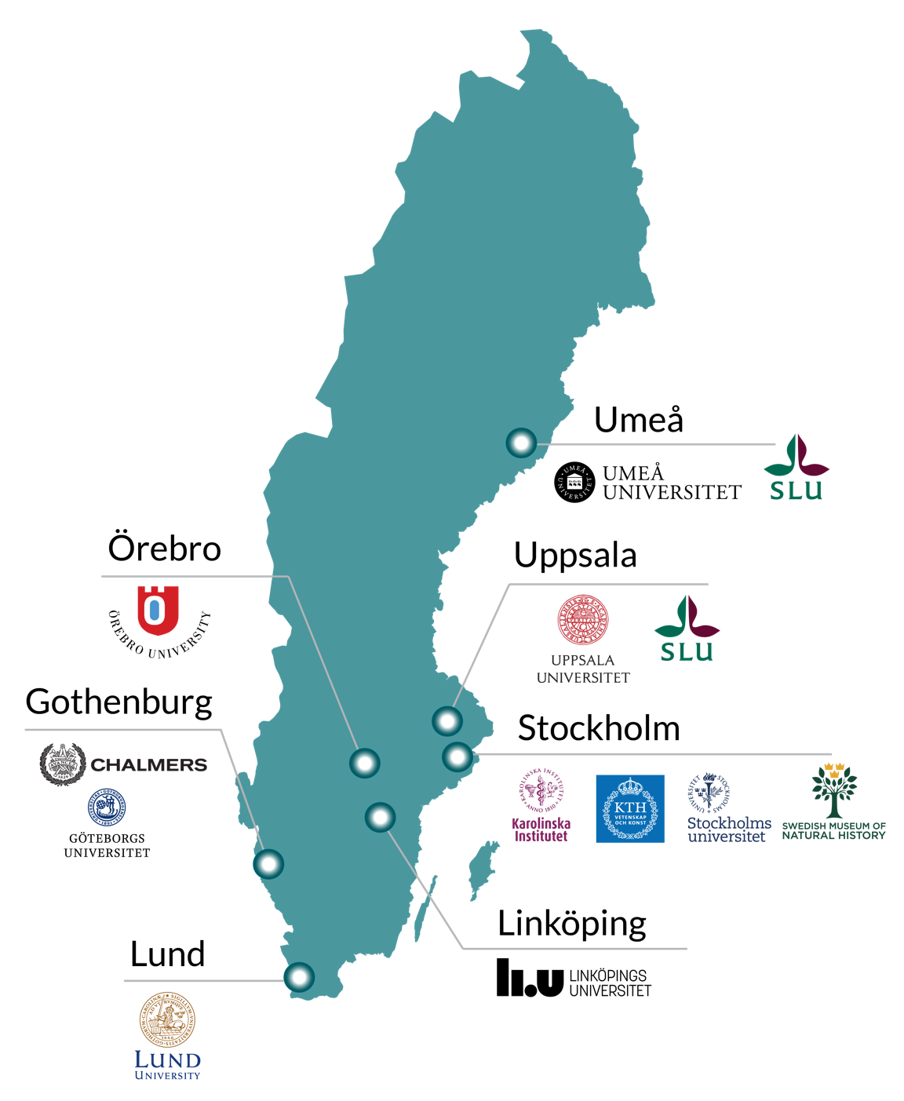

What is SciLifeLab?
National hub enabling life science
research that would otherwise not be possible.
Activities at all major Swedish universities.
Organised in 10 technology platforms and 40 research units distributed nationally.
Study all molecular aspects of life, from the atomic scale up to entire ecosystems.
Applicable across a large spectrum of disciplines and research fields in life science
What do we offer?
Who can access it?
Advanced technologies
Unique instruments
Expert know-how
Academia
Industry
Healthcare
Other governmental agencies
International users

Slide 5
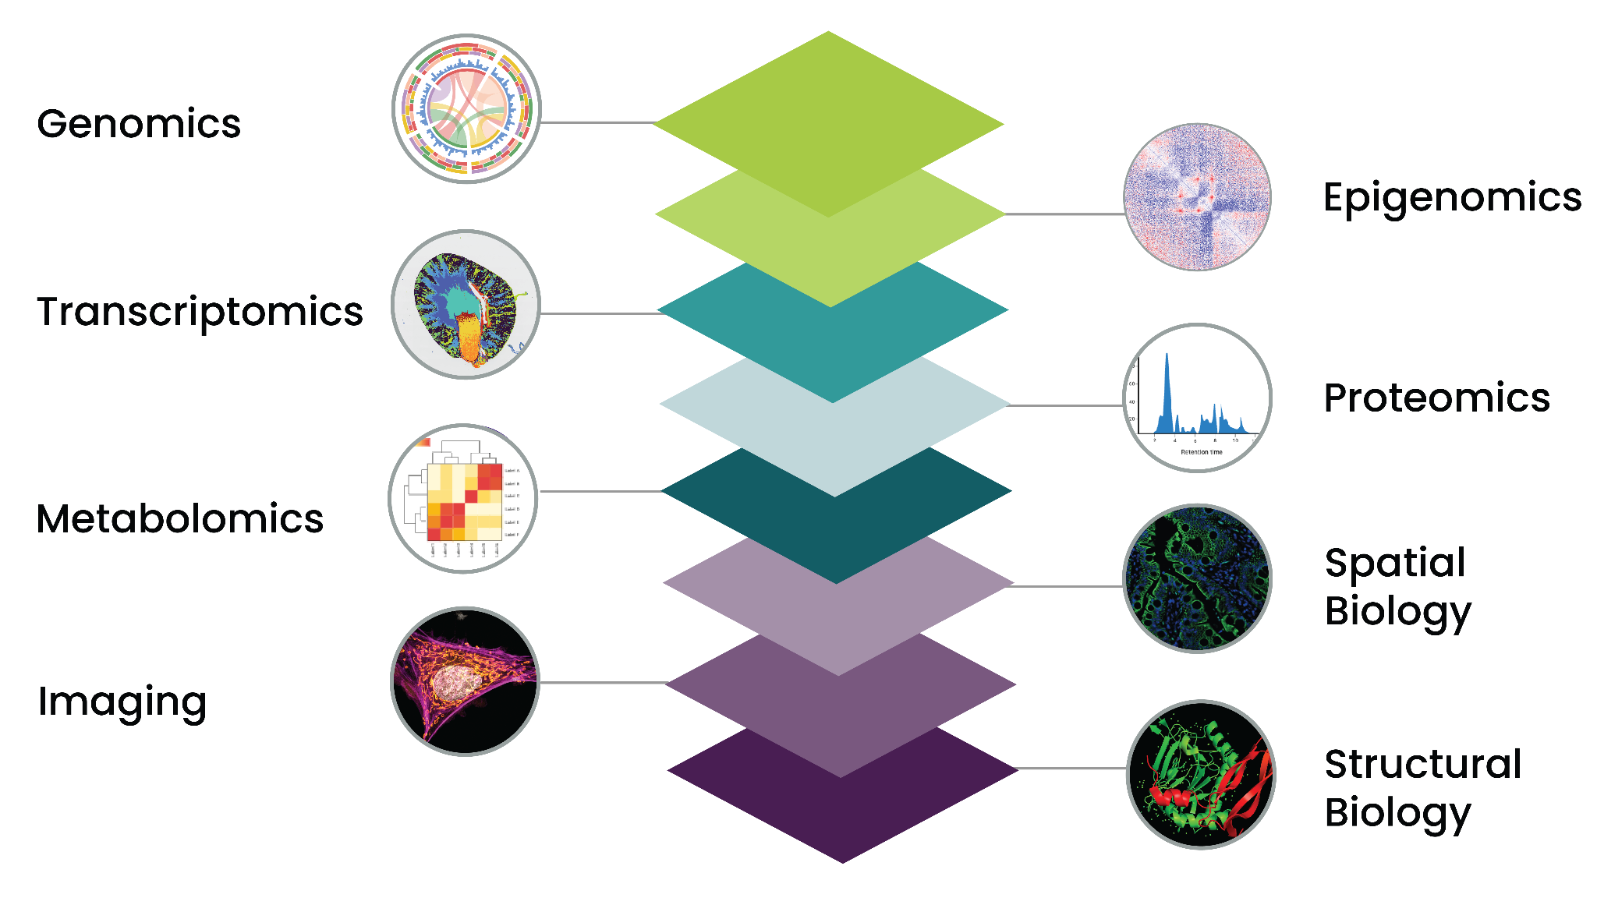
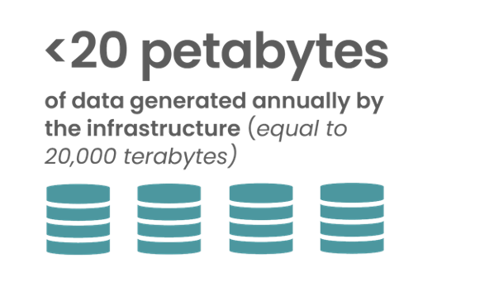
SciLifeLab platforms

Slide 6
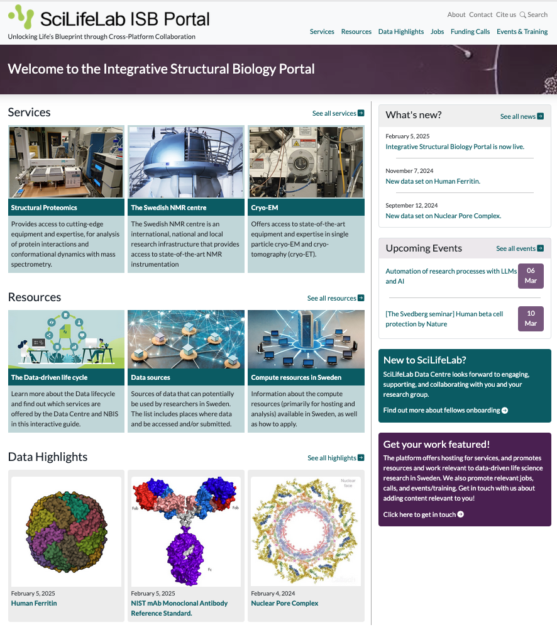
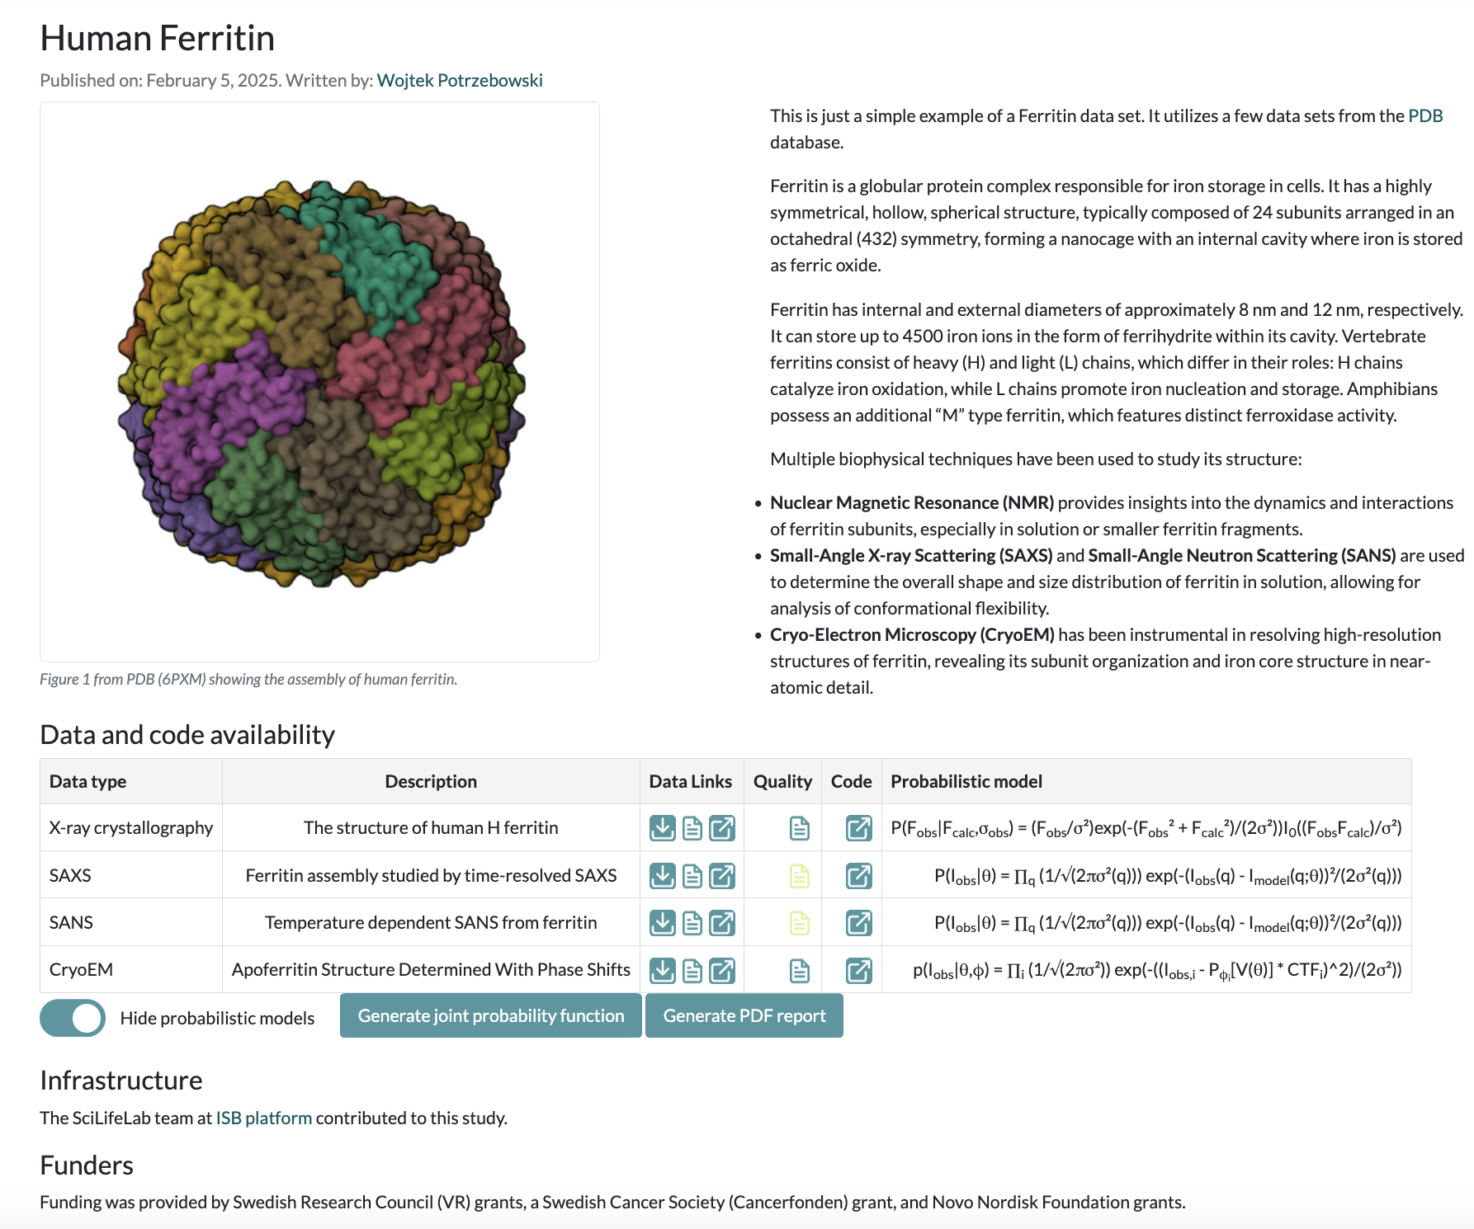
Integrated Structural Biology Portal
Draft!
Goal: Community portal providing a unique access to multimodal data and tools

Slide 7
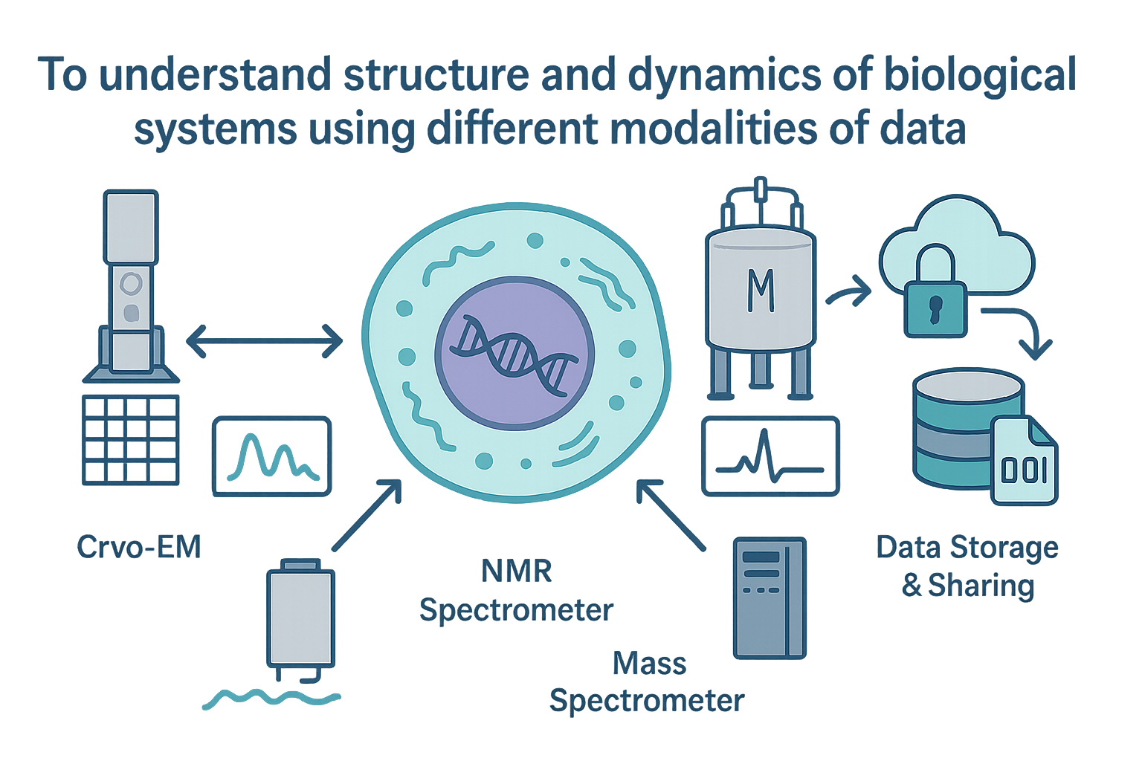

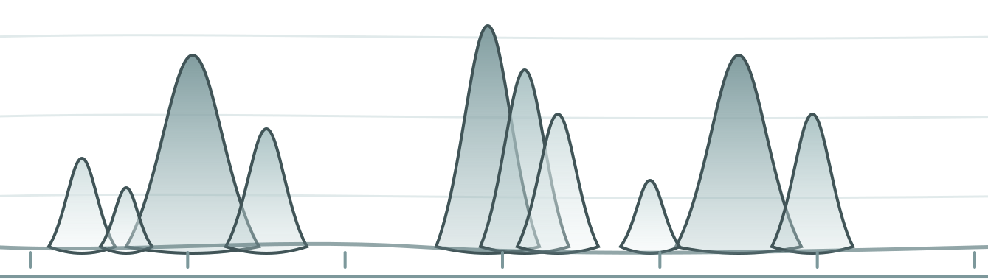

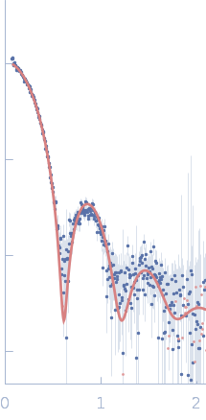
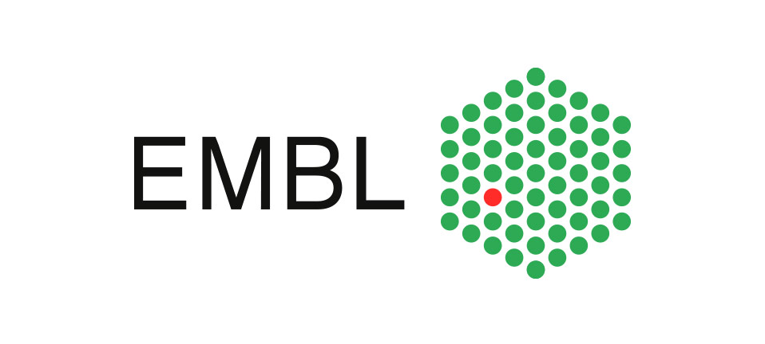




Additional data types
1) The Protein Data Bridge for ISB
Protein Production (LP3/PPS)
ISB Platform
2) Integrated data infrastructure for small-angle scattering data

Slide 8
Small Angle Scattering Analysis Toolkit

Slide 9
Learning objectives
Principles of Small Angle Scattering Data Analysis
Main functionalities of SasView
Newly developed features
SasView Community
Hands-on session
1D fitting
Creating custom plugin models
Simultaneous fitting
…

Slide 10


User Journey at Large-Scale Facility
Data reduction
Experiment control
Data streaming
Data analysis
User Office Software
Before experiment
During experiment
During and after experiment

Slide 11
User Journey
Facility
Responsibility+Expertise
Users
User Office Software
Experiment control
Data streaming
Data reduction
Data analysis

Slide 12
Data analysis – facts of life
Data analysis is part of the processing workflow
Reduced data on the disks is useless
Users expertise is critical for successful data analysis
Facilities should support data analysis software but shouldn’t fully drive the process
->We need open and collaborative software tools to succeed!

Slide 13
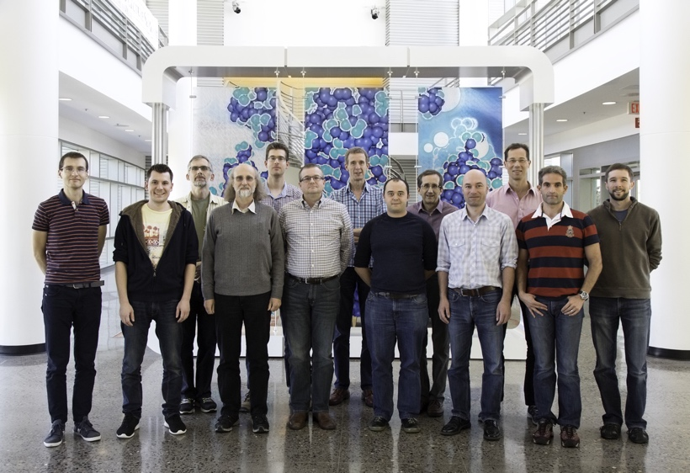
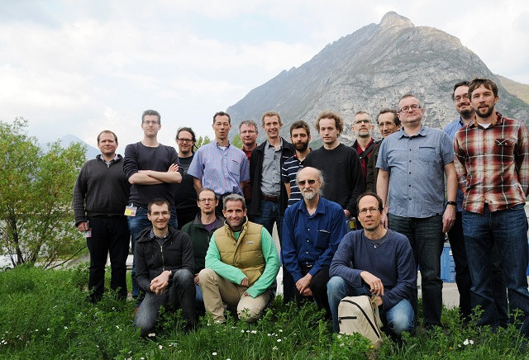
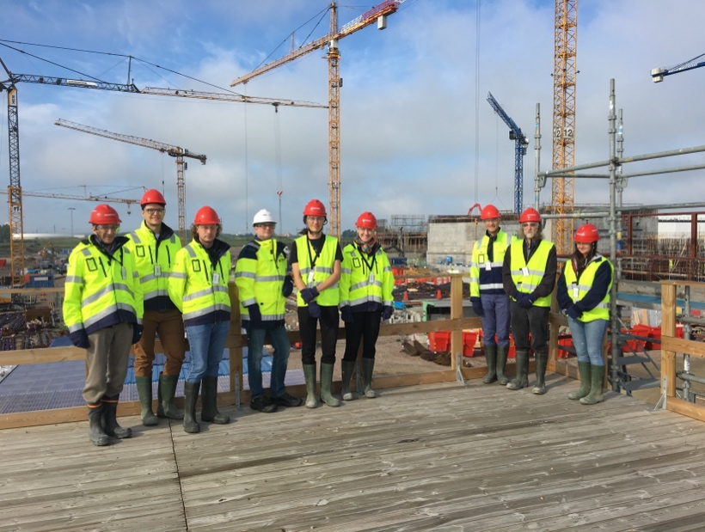
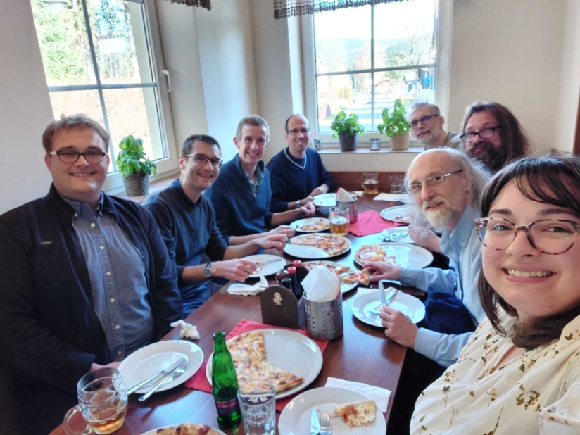
The SasView approach
An open, collaborative, community development
Community-driven project
Supported by 10 facilities, 40 contributors (~15 active at any one time)
Small leadership team
Paul Bulter, Jeff Krzyown (NIST)
Paul Sharp, Steve King (ISIS)
Wojtek Potrzebowski (SciLifeLab)
Biweekly calls
Regular SasView camps and hackathons
Hosted on github: https://github.com/SasView/sasview
Pictures from Contributor Camps: V, VI, VIII, X
www.sasview.org

Slide 14
SasView collaboration
Those who bring the resources (time, effort, funds) choose what to work on
but cannot break existing experiences ...

Slide 15
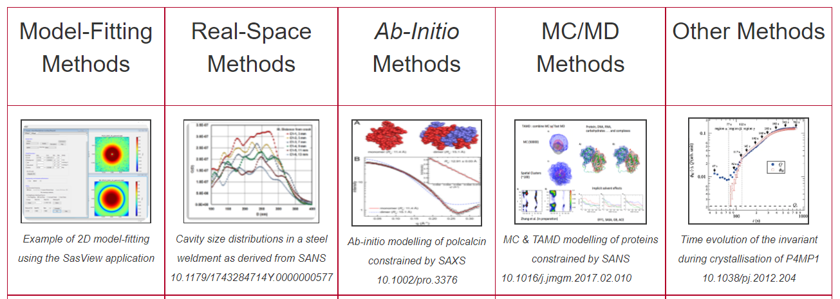
Different approaches to SAS data analysis
Not in SasView scope
https://www.isis.stfc.ac.uk/Pages/SANSdataanalysisOverview.aspx

Slide 16
Typical SasView workflow
For reduced data:
Load and plot experimental data
Define a model (form and structure factor) with parameters
Fit the parameters so that model matches experimental data
Draw scientific conclusions and publish results!

Slide 17
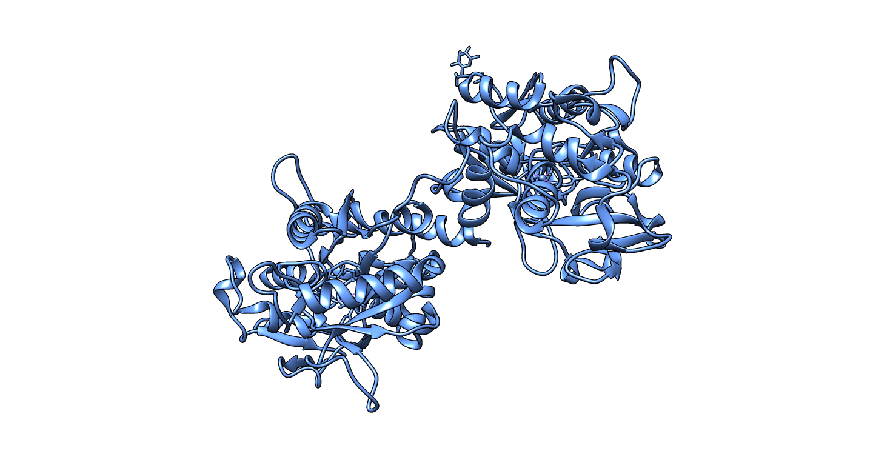
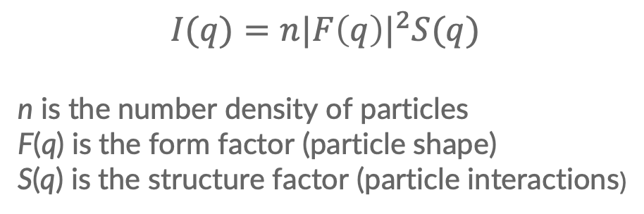
Defining model is crucial for data analysis
$$I(q)=n{|F\left(q\right)|}^{2}S(q)$$
n is the number density of particles
F(q) is the form factor (particle shape)
S(q) is the structure factor (particle interactions)
Protein structure coordinates
Cylinder radius = 40Å, lenght = 200Å
Hardsphere, effective radius = 50Å

Slide 18
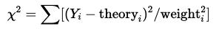
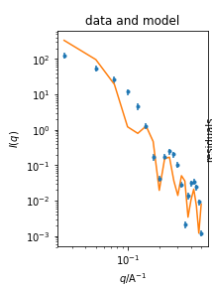
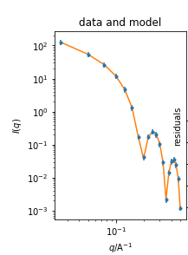
Fitting model to data through χ² optimization
 | Before fit
model
lenght | 350 Å
radius | 35 Å
 | 416.9
After fit
400 Å
40 Å
0.03

Slide 19
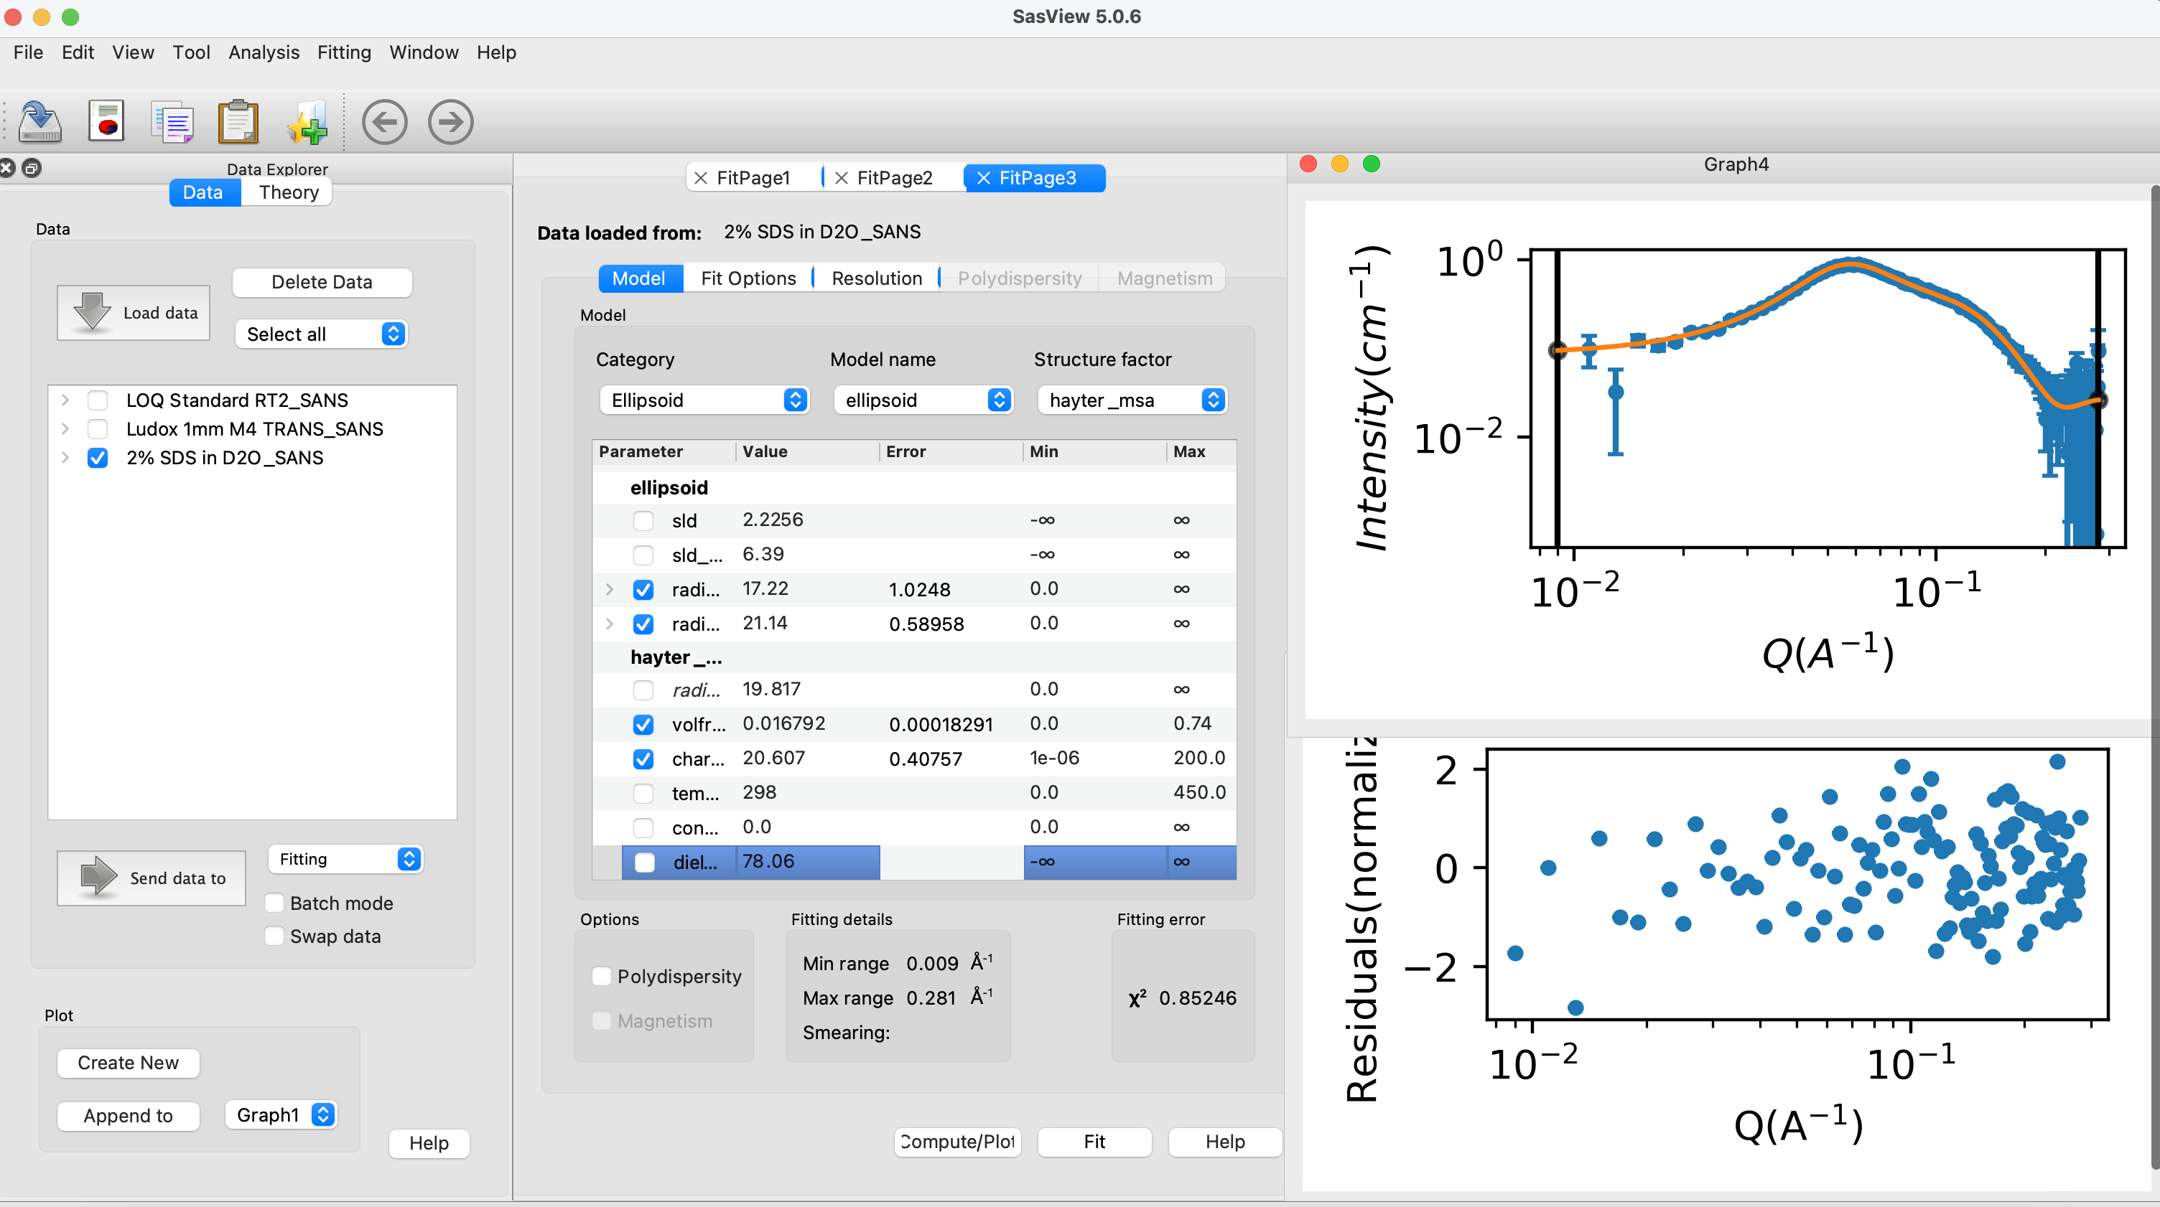
70+ models to explain data
Wide choice of built-in models (> 70)
F(Q), S(Q) & F(Q)*S(Q)
Single, batch and simultaneous 1D and 2D fitting
Data management
Common data formats supported, including NXCansas & cansas1D
Analysis Tool Choice
&
Plotting
Polydispersity (choice of distribution and distribution parameters)
Resolution smearing (pinhole and slit)
Automatically from data or provide parameters

Slide 20
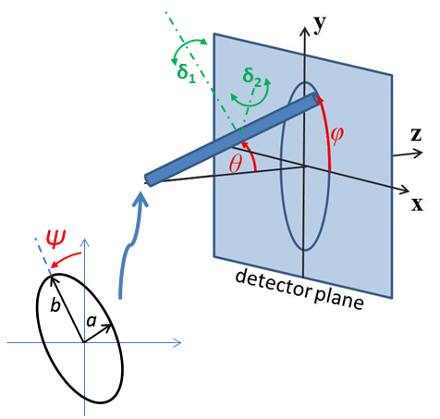
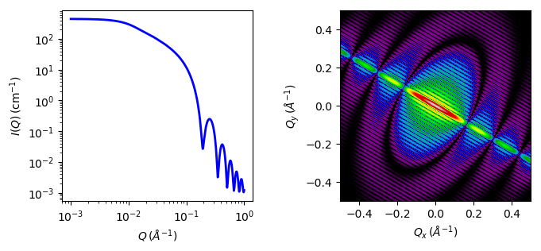
2D fitting for oriented or magnetic particles
1D and 2D cylinder model

Slide 21
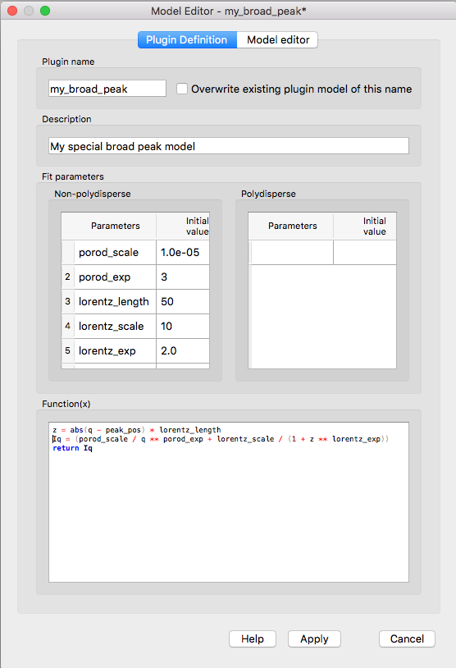
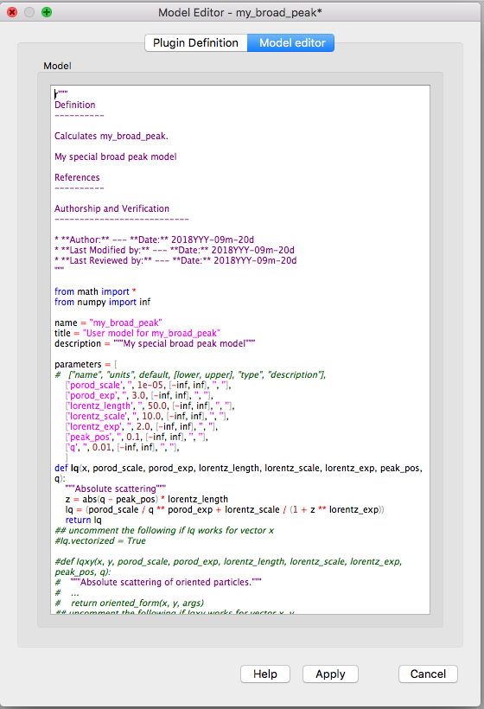
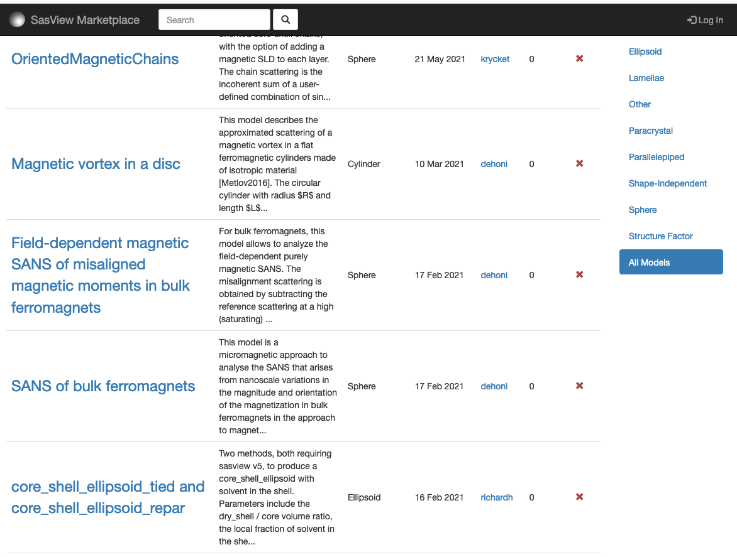
Plugin models
Dedicated editor
Syntax and performance testing
Directly available in SasView ecosystem
Community developed models can be deposited to marketplace: https://marketplace.sasview.org/

Slide 22
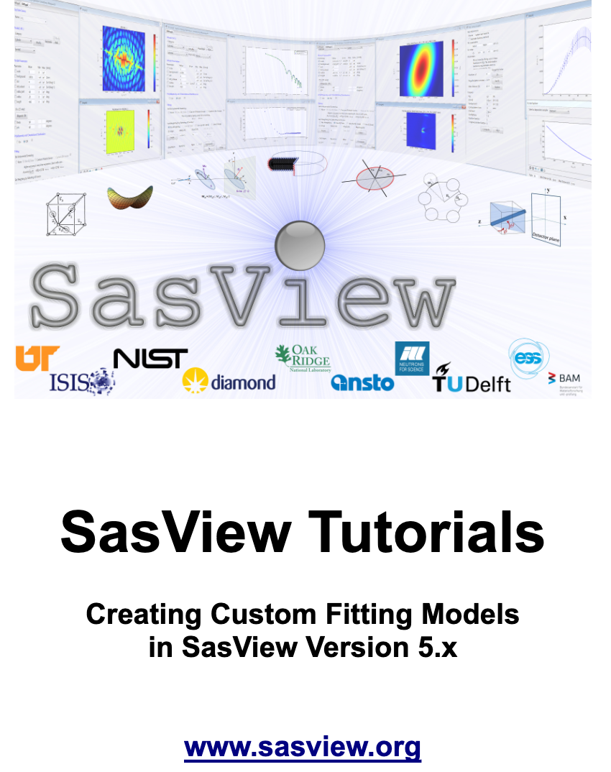
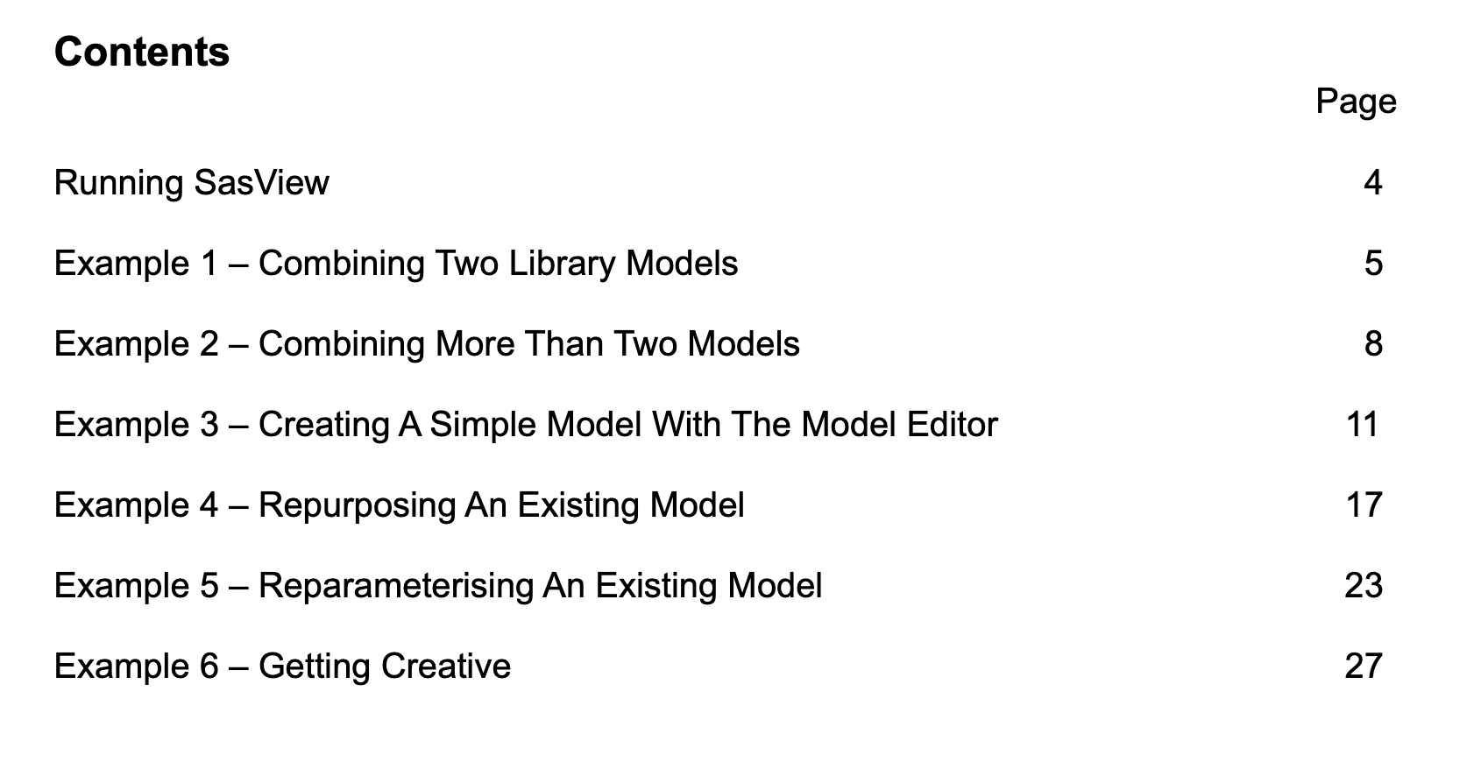
Plugin models tutorial
Available at https://www.sasview.org/download/

Slide 23
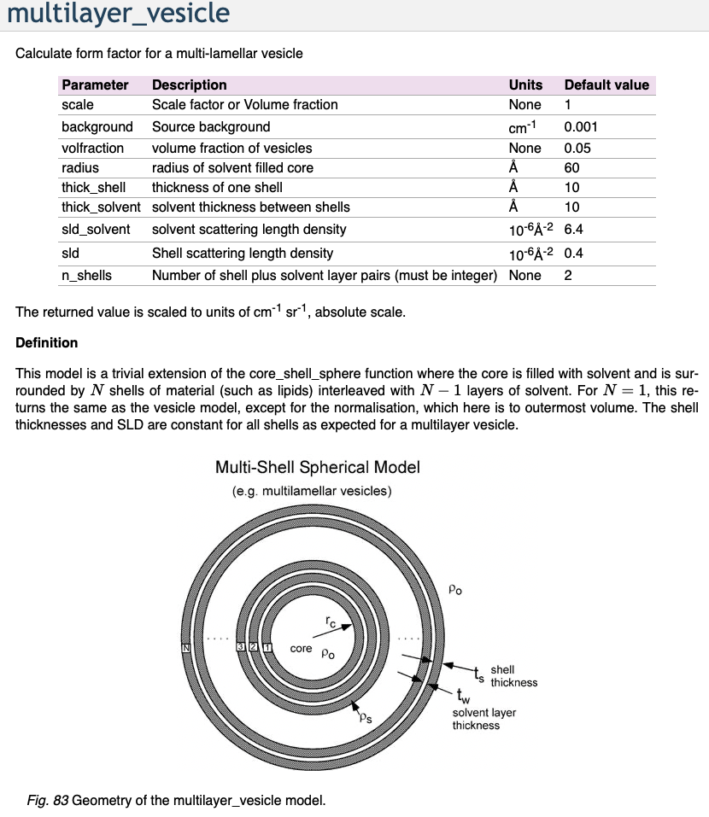
Which model should I use?
Prior knowledge
Literature search
SasView documentation
Usually, more than one model fits
Model-free analysis

Slide 24
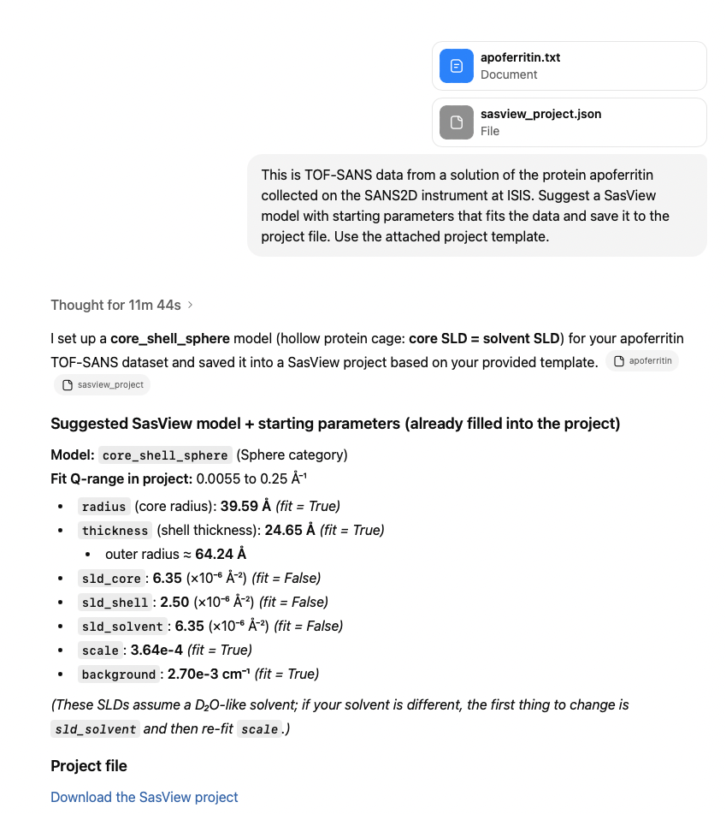
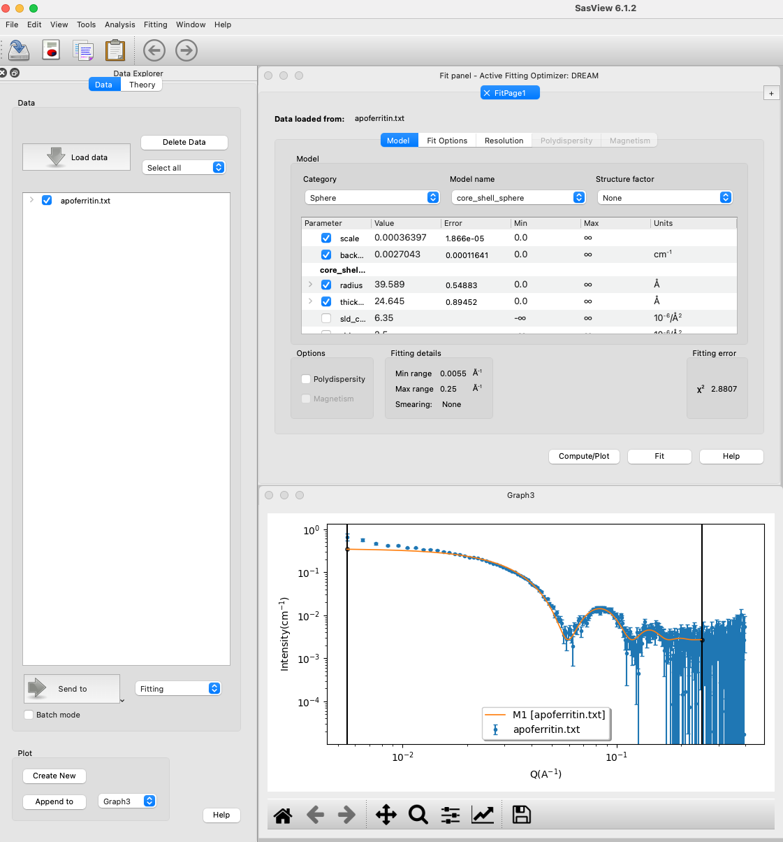
LLMs can of course help...

Slide 25
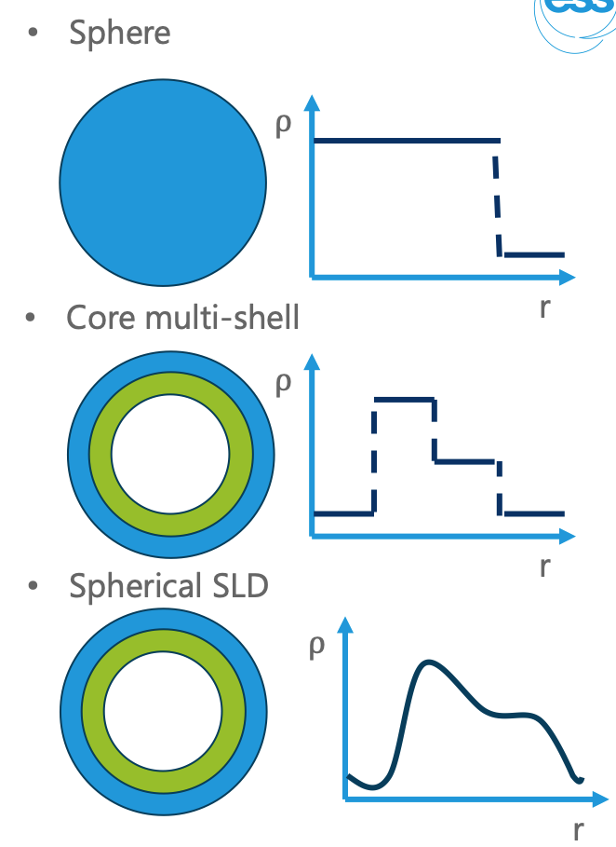
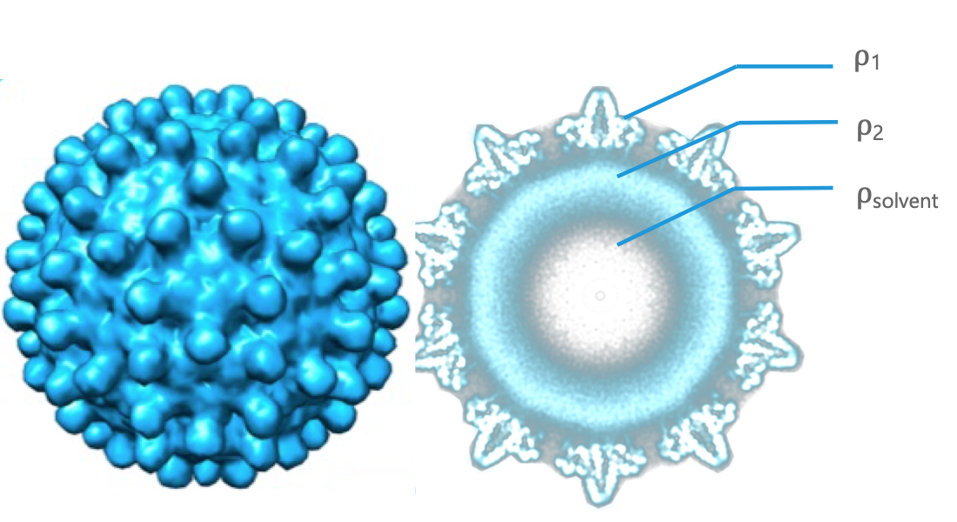
How to represent a virus capsid?

Slide 26
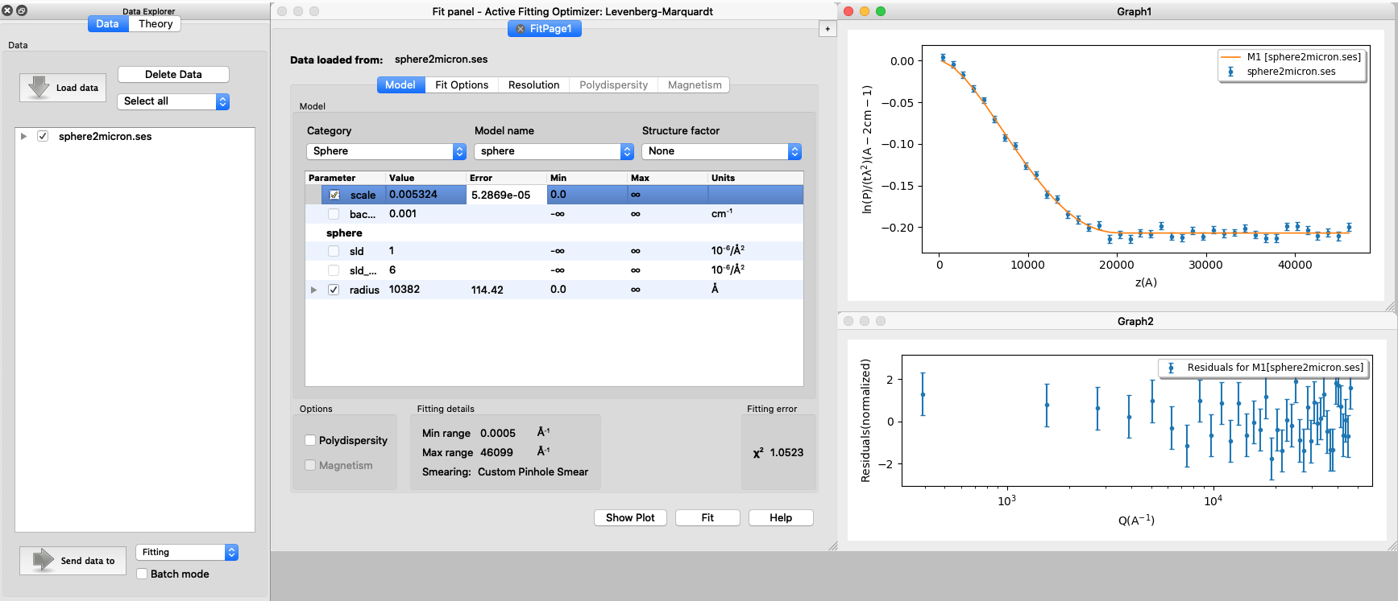
SESANS data
SasView recognizes SESANS data and starts specific workflow
Automatic Hankel Transform of SANS models
Access to all SasView models

Slide 27
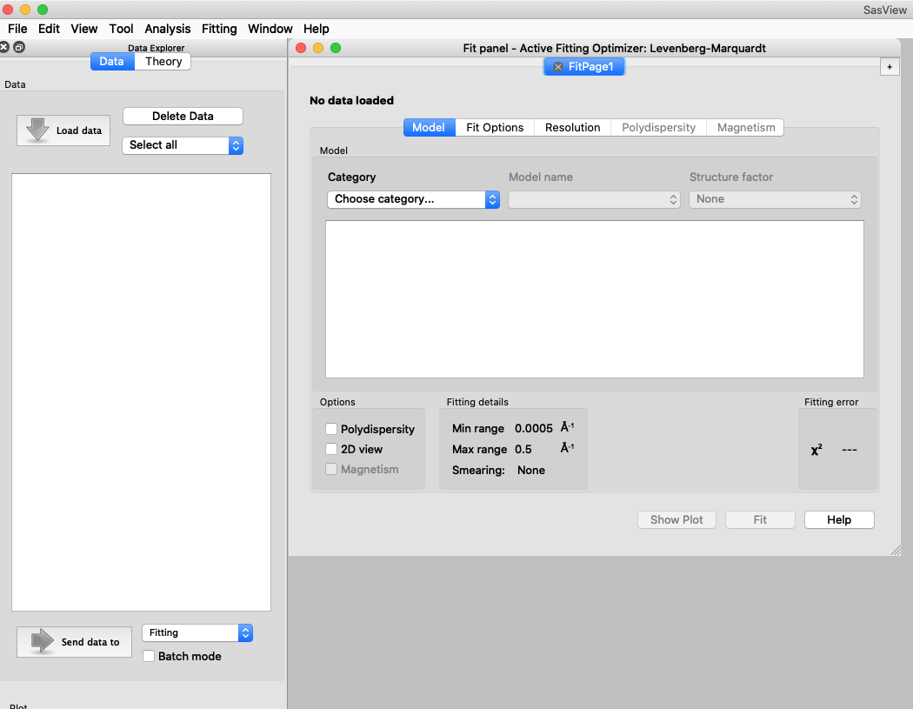
Other SasView functionality
Tools
Data Operation
SLD calculator
Density/Volume calculator
Slit Size Calculator
Kiessig Thickness Calculator
Q Resolution Estimator
Generic Scattering calculator
Orientation Viewer
Python Shell/Editor
Image Viewer
File Converter
Analysis
Fitting
Invariant
Pr Inversion
Correlation Function

Slide 28
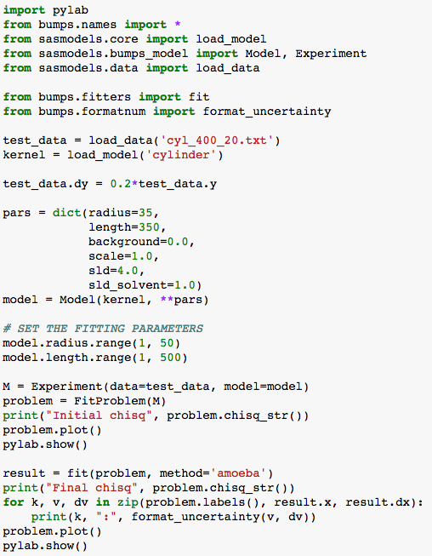
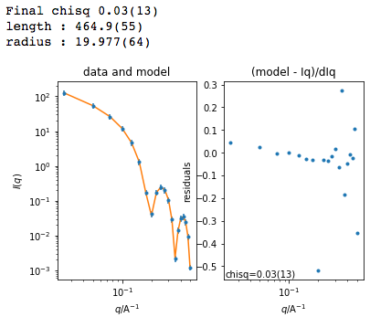
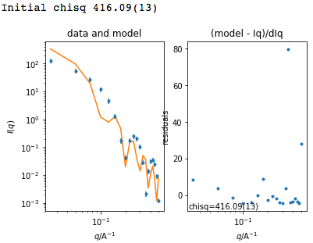
Beyond Graphical User Interface (GUI)
Useful for batch jobs and reproducibility
Scripts can be run on computer cluster
Before fit
After fit

Slide 29
Beyond Graphical User Interface (GUI)
sasview
sasdata
sasmodels
bumps
Python installation
For fitting, there is no need to install sasview
Pip install sasmodels sasdata bumps
It can be run on computer clusters (also with GPU)

Slide 30
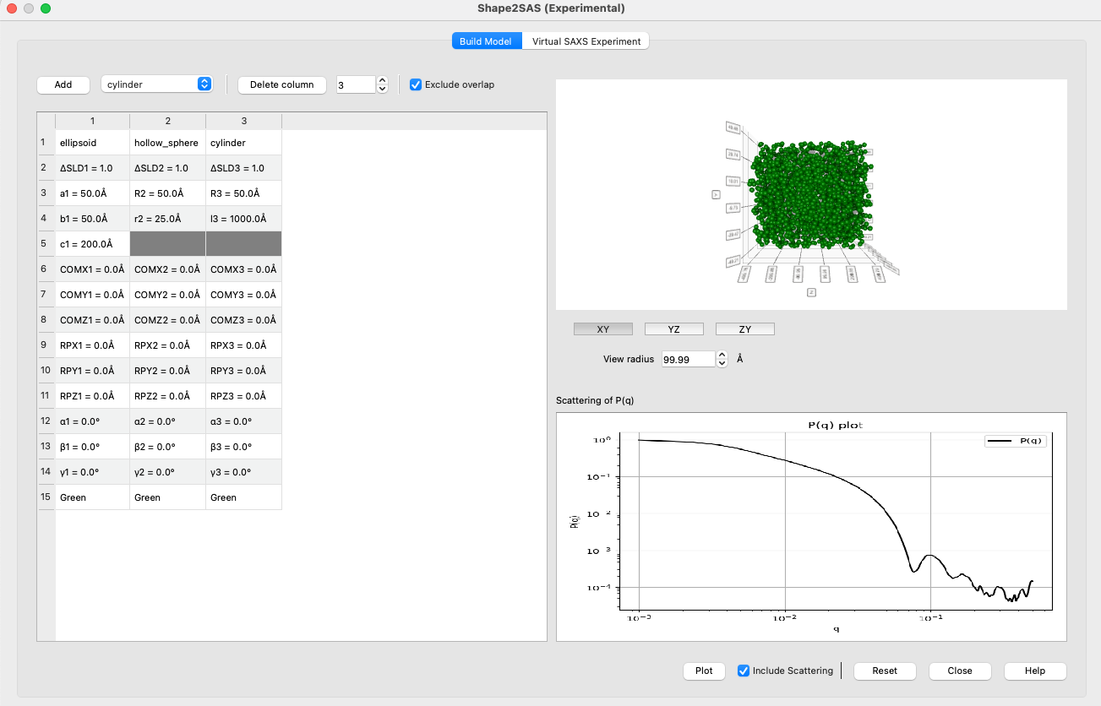
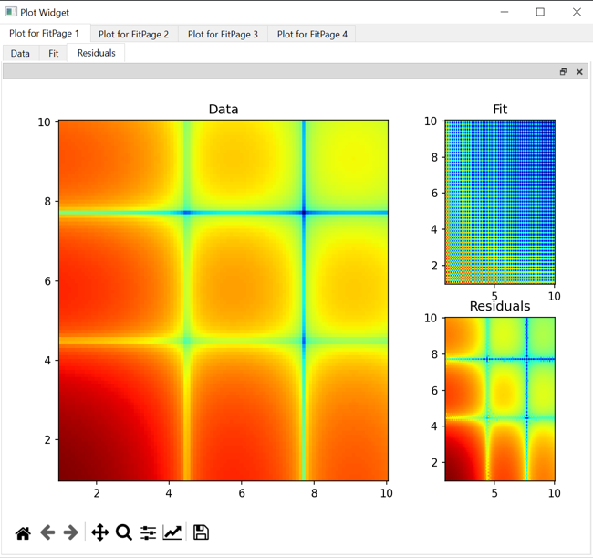
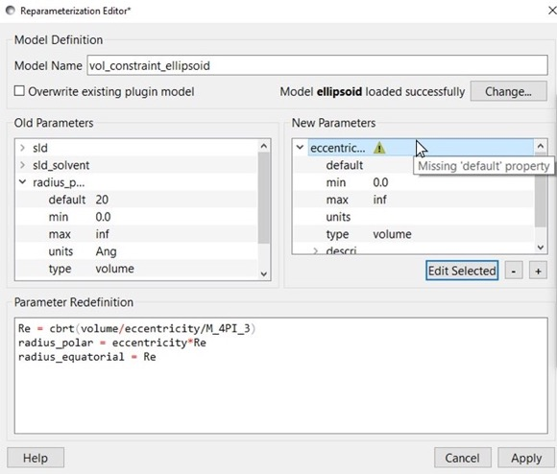
Contributed projects
Simultaneous SAXS and SANS fitting
Improvements in:
Plotting
Data structure
Documentation
Plugin Editor
Slicers
Generic Scattering Calculator
Web-based API
Pore size distributions
New Tools: Shape2SAS, MuMag
Contributors: Iestyn Cadwallader-Jones, Nouhalia Agouzal, Dorian Lozano, Julius Karliczek (ILL), Ellis Hewis, James Crake-Merani, Ruben Lopes (ISIS), Alex Zheng (NIST), Brayden Miller (NIST), Xael Shan (NIST), Anita Zhang (Princeton), Kristian Lytje (Arhus University), Thomas Bukholt Hansen, Andreas Larsen (KU)

Slide 31
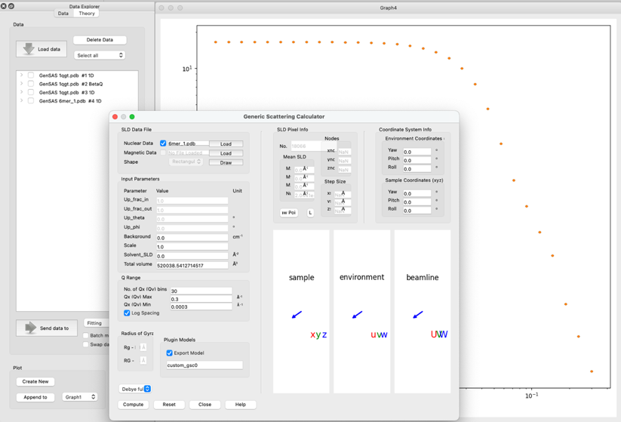
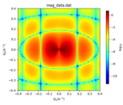
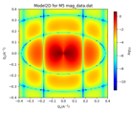
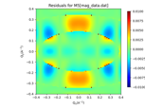
Generic Scattering Calculator improvements
Magnetic/polarized SANS
Generic Scattering Calculator supports magnetic/polarized SANS
Coordinate data in VTK formats supported
Interacting bio-molecules
Generate scattering profile from PDB file
Save as a custom/plugin model
Use for fitting with structure factors (including beta approximation)
PDB reader and engine refactored
Validation of electron-microscopy maps using solution small-angle X-ray scattering
Kristian Lytje and Jan Skov Pedersen, Volume 80| Part 7| July 2024| Pages 493-505

Slide 32
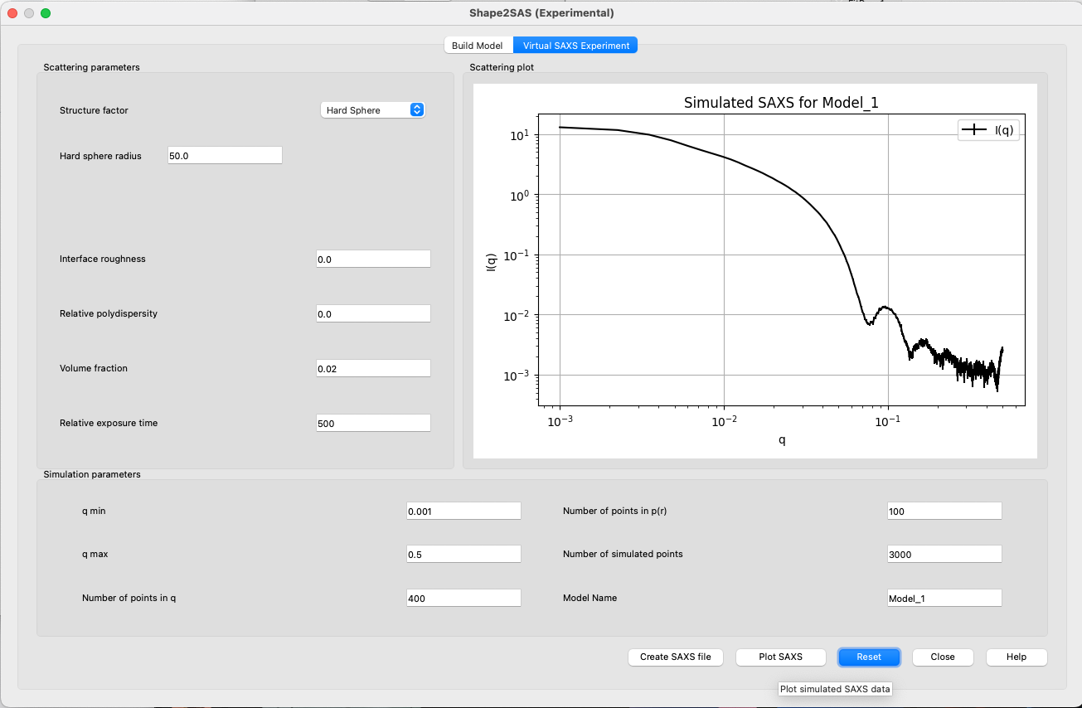
Shape2SAS
Shape visualization
Shape definition
Scattering profile
Structure
factor
Shape2SAS: a web application to simulate small-angle scattering data and pair distance distributions from user-defined shapes.
Andreas Haahr Larsen,^{a*} Emre Brookes,^{b} Martin Cramer Pedersen^{c} and Jacob Judas Kain Kirkensgaard^{c,d}
Profile saving

Slide 33




SasView 6.x
New analysis tools – Shape2SAS, MuMag, and Size/Pore-size Distribution.
Improved P(r) and Corfunc
Reworked fitting panel with better multi-dataset and error handling.
Enhanced model editor, re-parameterisation, and new/updated models.
New slicers, orientation viewer, residual guides, and plot controls.
New preferences dialog and standardised user file locations.
Improved documentation and examples

Slide 34




Resources for users and developers
Website
Documentation
in-program & online
Written Tutorials
Video Tutorials (YouTube)
Taught Courses
scattering schools/workshops
university courses
Bootcamps & regional workshops
e-Learning
Slack
Twitter
(Marketplace)
help@sasview.org
users@sasview.org

Slide 35
How to contribute
Respond to queries posted to help@sasview.org or github
Teach others how to get the best from SasView
Write and improve documentation
Write and record tutorials
Test SasView (over and over!) and write bug reports
Provide new plugin models
Deploy and improve automated testing
Review the code contributions of others
Develop code in Python3/C and PyQt/Matplotlib
www.sasview.org/contribute

Slide 36

Hands-on session
New to SasView? Start here
2
2’
3
https://www.sasview.org/documentation/

